Slide 3
Handouts
Contact information
GMS Shared Values (Social Matrix)
Bring Your Own Device (BYOD)
School-Wide Incentive calendar

Slide 4
Introductions
We are here to help you be successful!
Mr. Joens, Principal
Mrs. Mobley, Mrs. Kledzik & Ms. Schultz Assistant Principals
Ms. Lehmker & Ms. Nicolas, Guidance Counselors
Mrs. McGuire & Ms. Sidney, Social Workers
Mrs. Coile, School Psychologist
Mrs. Giarratano, School Nurse
Mrs. Pressler, Clinic
Mrs. Bowers, Front Office
Mrs. Wolf & Mrs. Balaban, Guidance Office
Officer Wade, School Resource Officer
Mrs. Niland & Mr. Smith, Student Discipline

Slide 5
The Big Picture of GMS
Essential Question: What and who do I need to know in order to be academically and socially successful as a Buccaneer?

Slide 6
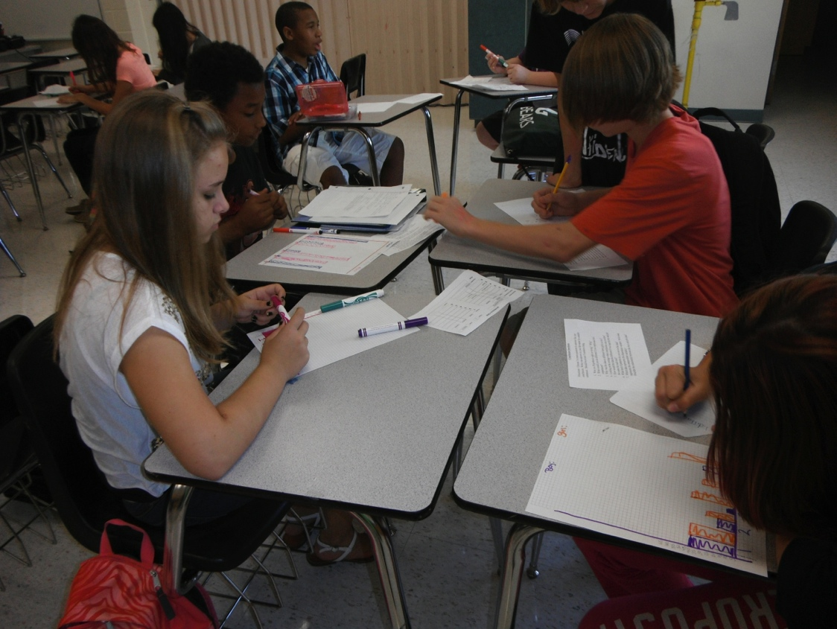
What are your academic goals?

Slide 7
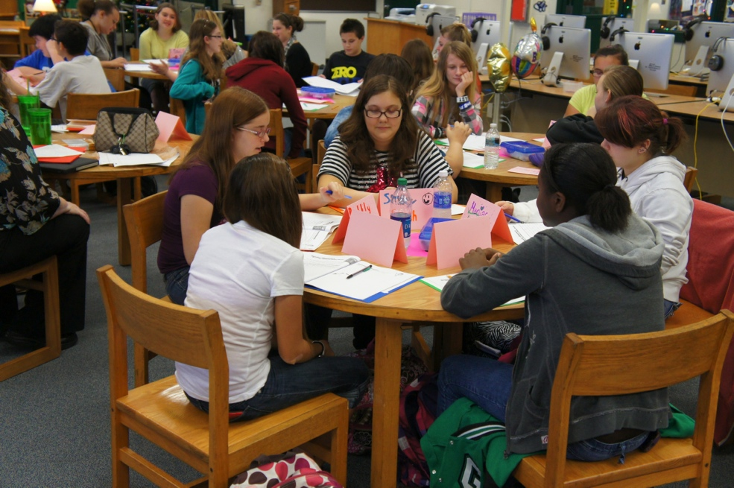
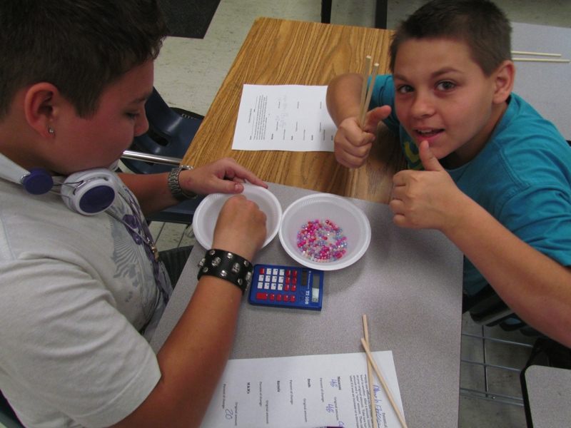
GMS Has 5 Academic Goals
Annual yearly progress
Promotion to next grade level
Promotion from MS to HS
High school diploma
College, career, and life ready

Slide 8
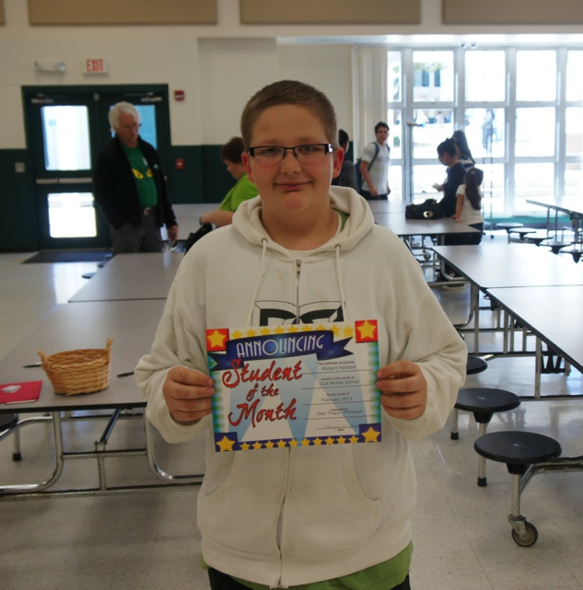
How Are Students Rewarded?
Academic Rewards
Quarterly honor roll
School – Wide incentives
Participation in extra – curricular activities
Academic competitions
Elective choices
Promotion to next grade and/or high school

Slide 9
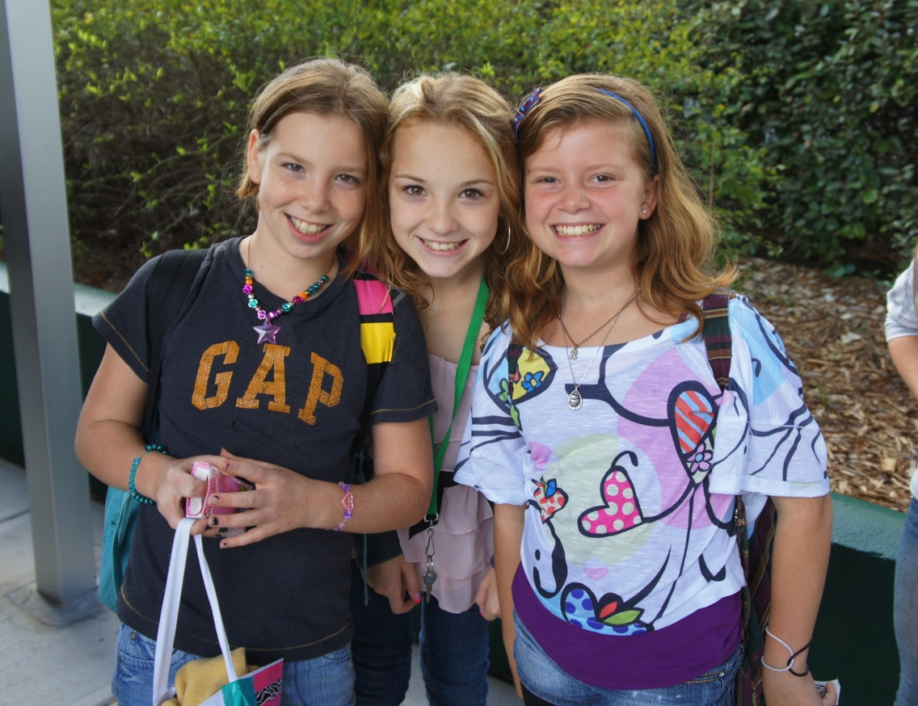
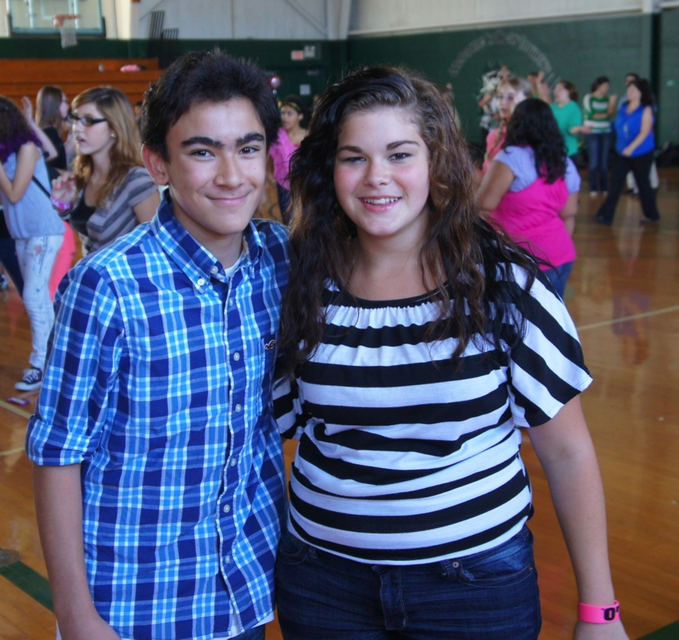
What Are Your Social Goals?

Slide 10
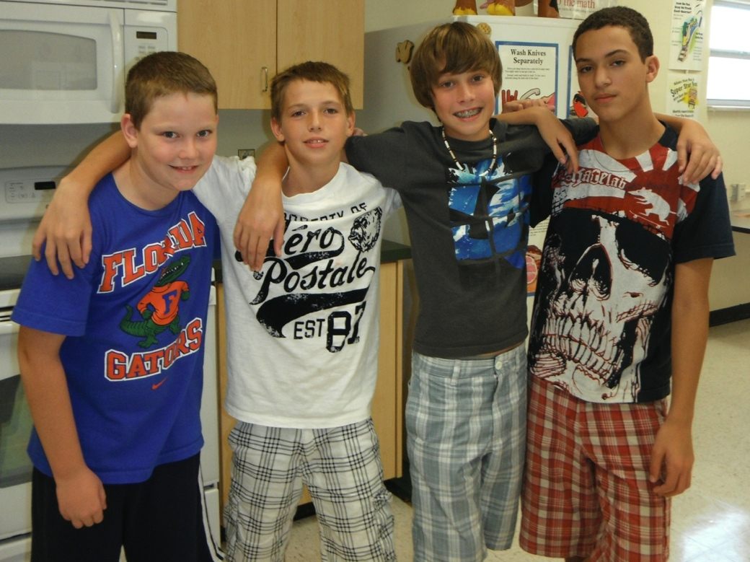
GMS Has Social Goals Based Upon These Shared Values:
Be Respectful
Be Responsible
Be a Problem Solver
and most importantly
Be a Buccaneer!

Slide 11
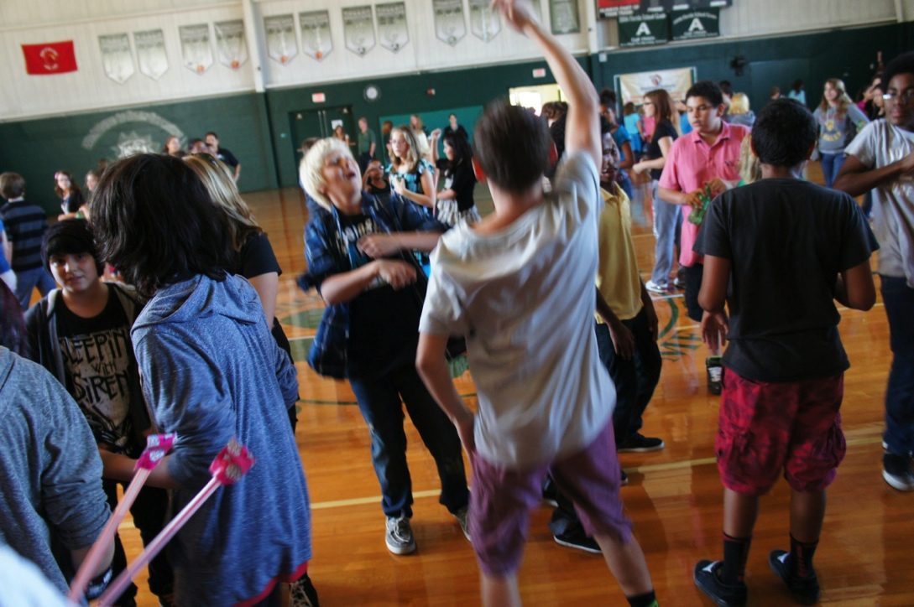
How Are Students Rewarded?
Social Rewards
Student of the month
School-Wide incentives
Bucs Bounty drawing (on Fridays)
Extra-curricular activities

Slide 12
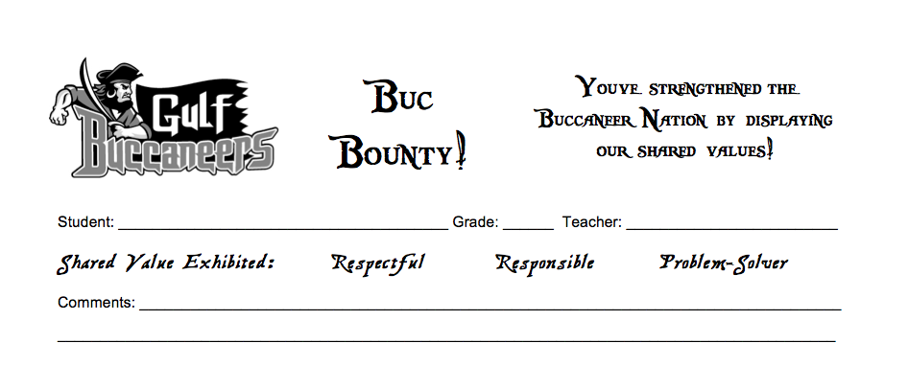
Buc Bounty 2014 - 15

Slide 13
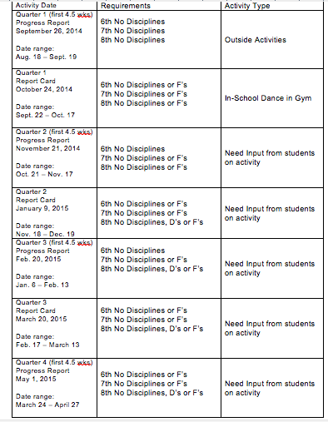
School-wide Incentive Calendar 2014 - 15

Slide 14
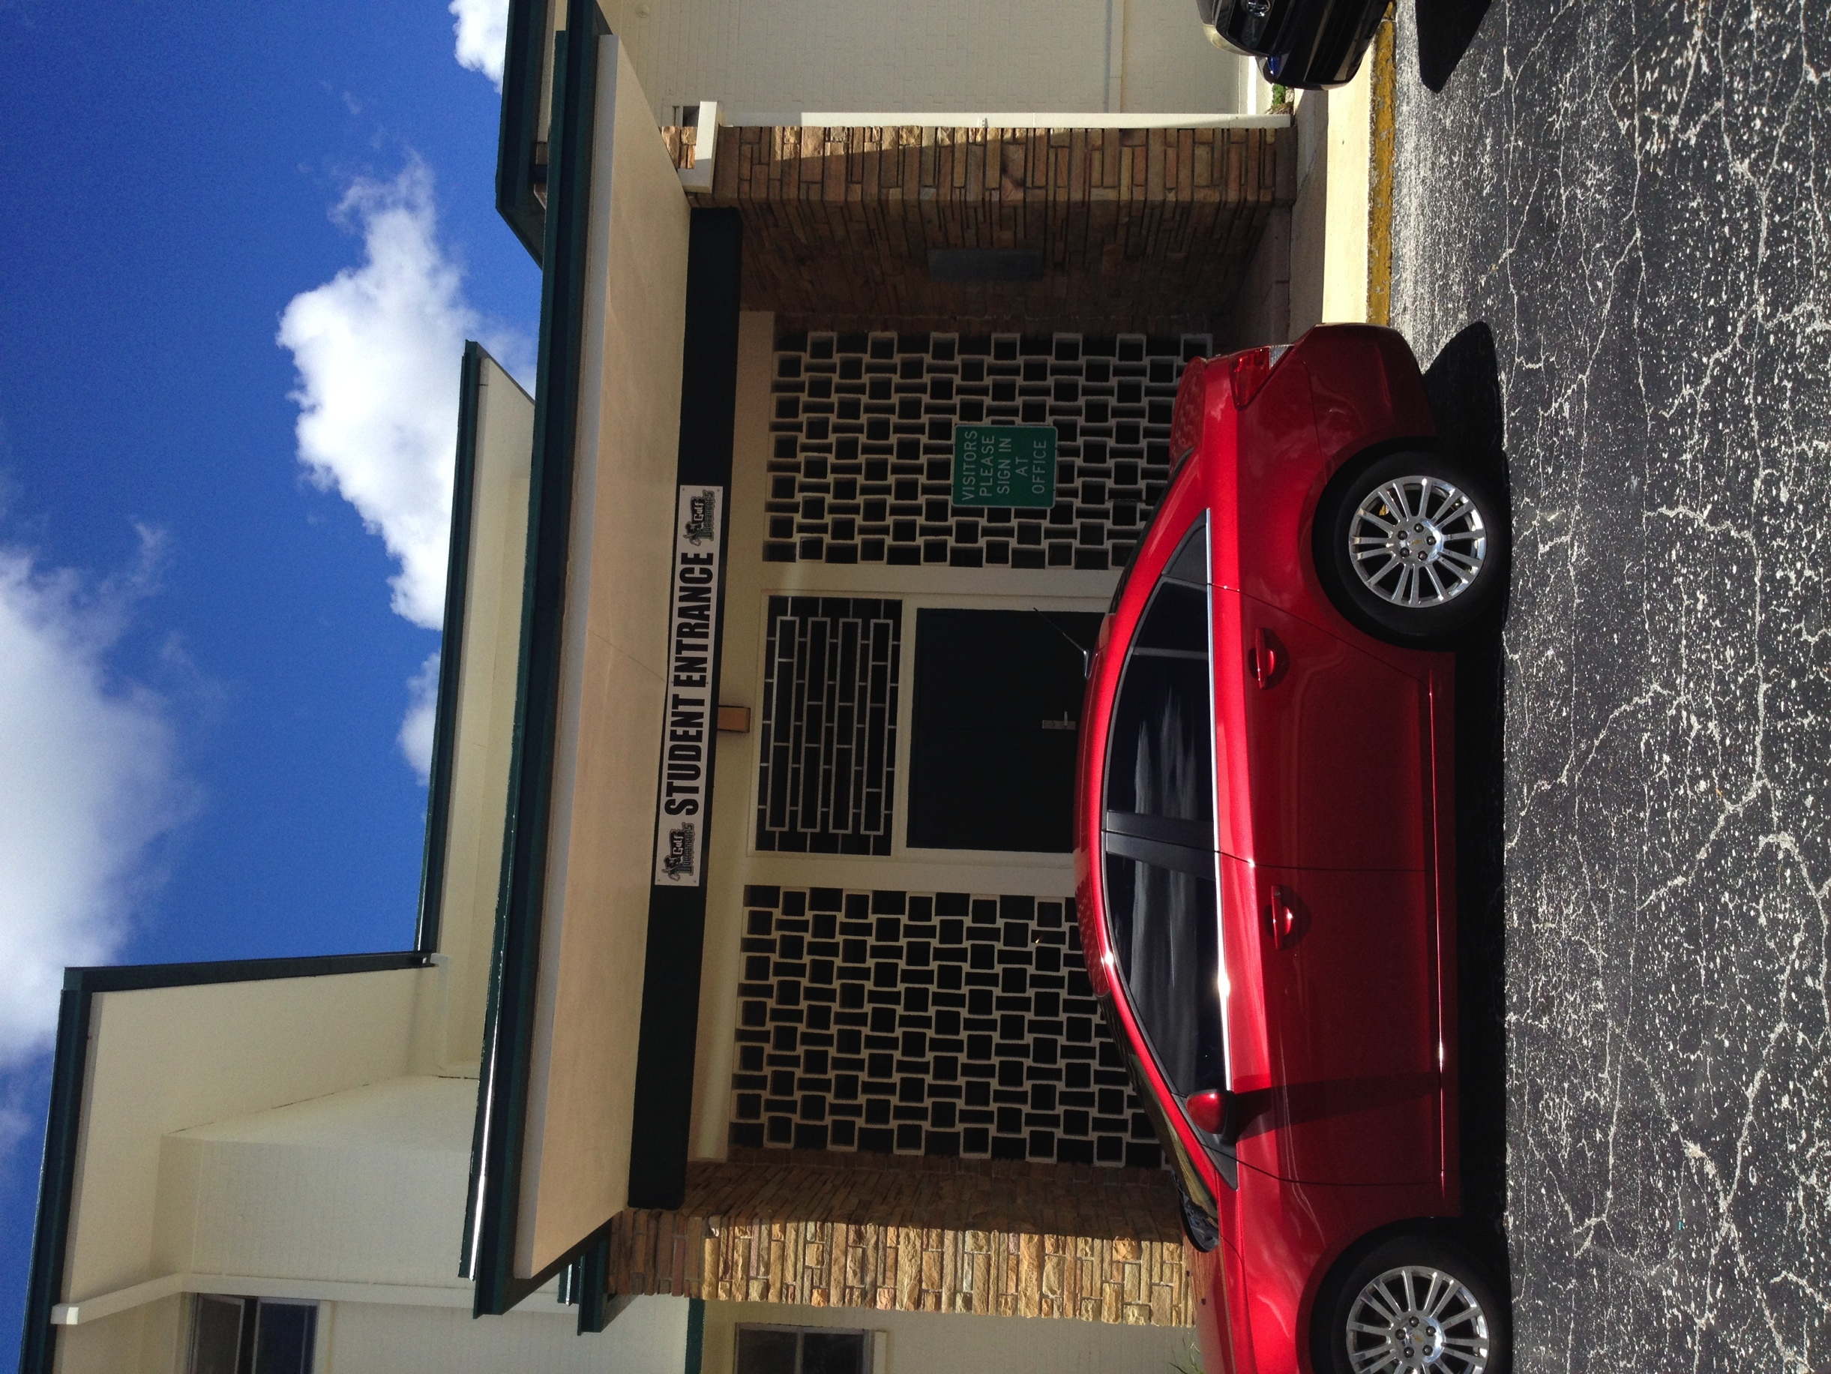
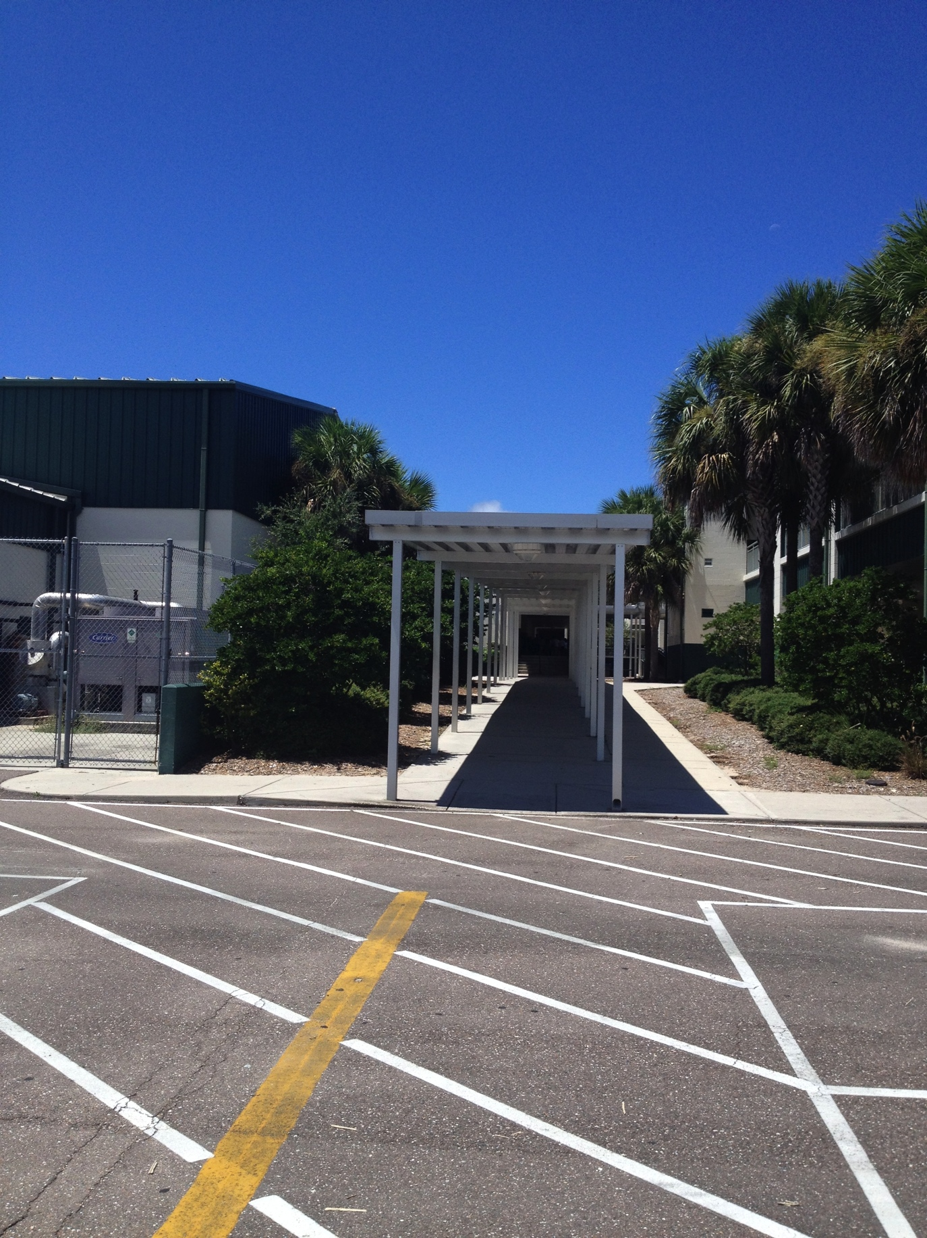
In The Morning Before School:
Entry points for students

Slide 15
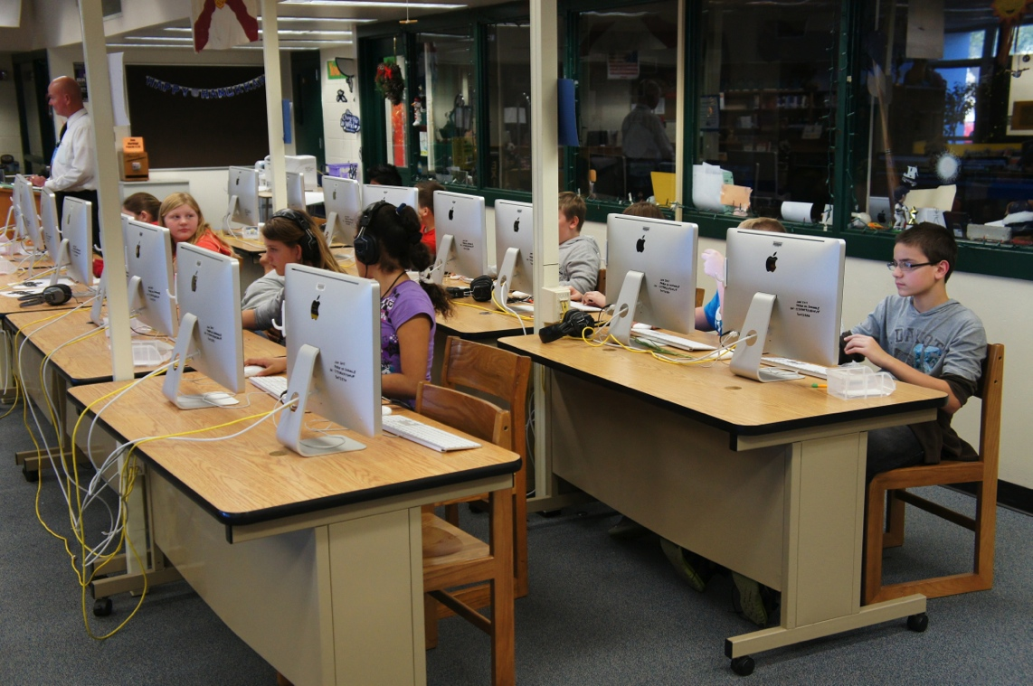
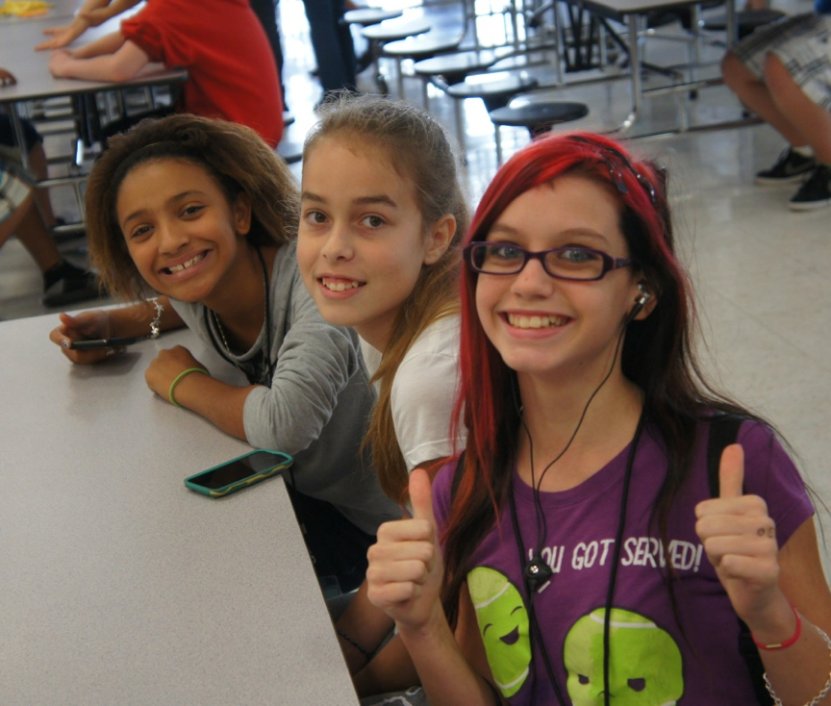
In The Morning Before School:
Wait in the courtyard/media/cafeteria/Good Start Room
Media center will be open 7:15-7:40 after the first few weeks of school

Slide 16
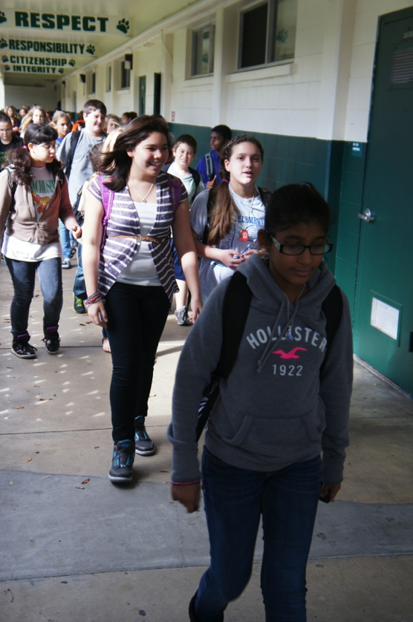
Class Schedule
7:15 am - First bell sounds, campus is open
7:40-7:44 - Moving to first period
7:45 - Bell sounds
Intercom welcome announcement
Tune into news for the Pledge of Allegiance
Four minute transition between classes
(For walking and restrooms, not standing and talking. Passes during class are issued for emergency situations.)
2:00 PM - End of instructional day, clear campus

Slide 17
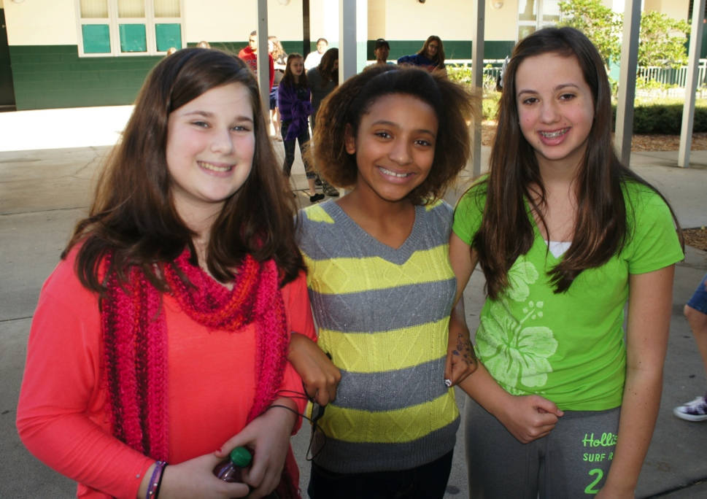
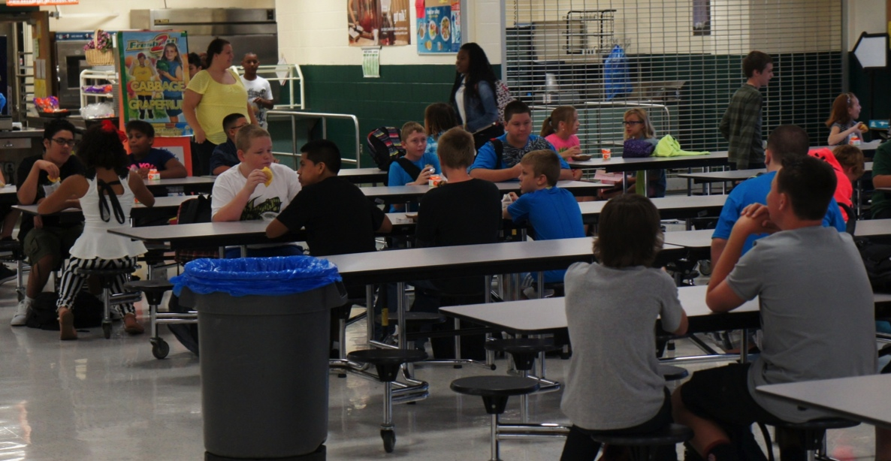
In The Morning Before School:
Good start club is located in 3-112 Room
During rainy weather you can move inside buildings early.
Remember that free breakfast is available to everyone in the cafeteria each morning.
Students enter classrooms at 7:40 A.M.

Slide 18
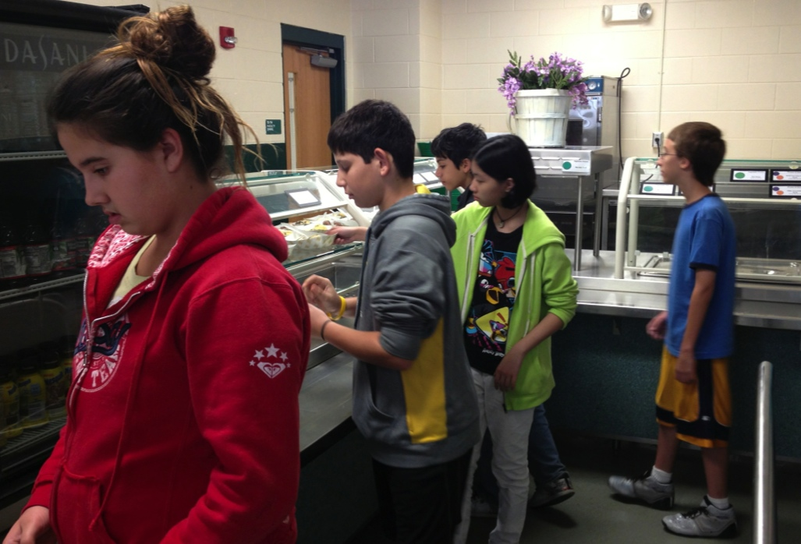
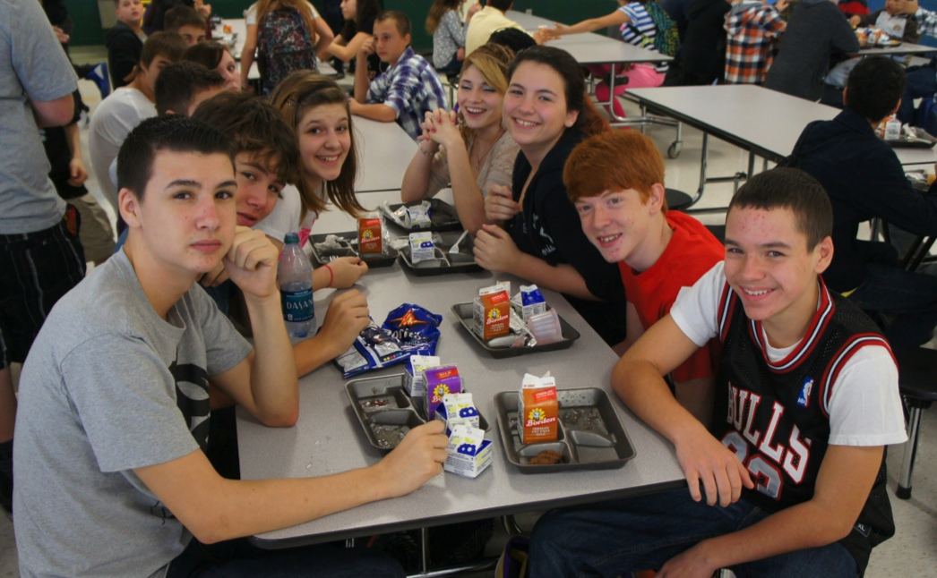
Lunch Procedures:
Walk in an orderly fashion to lunch and in the cafeteria
Price of lunch is $2.60 or $3.00
Know where to get your choice of food

Slide 19
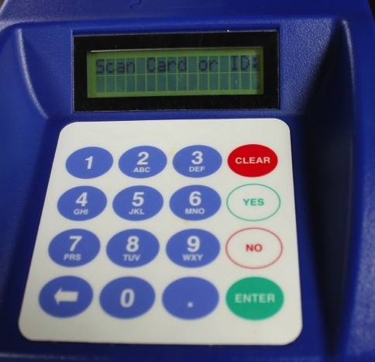
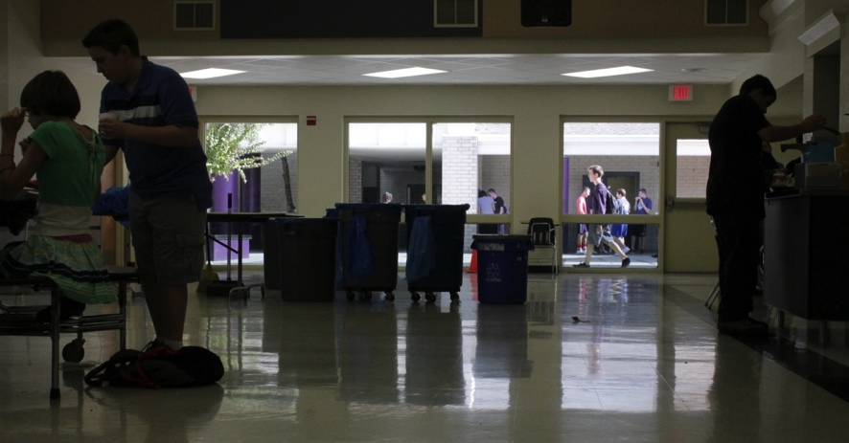
Lunch Procedures:
Know your lunch number and what you want to eat
Be responsible for your trash and recycling

Slide 20
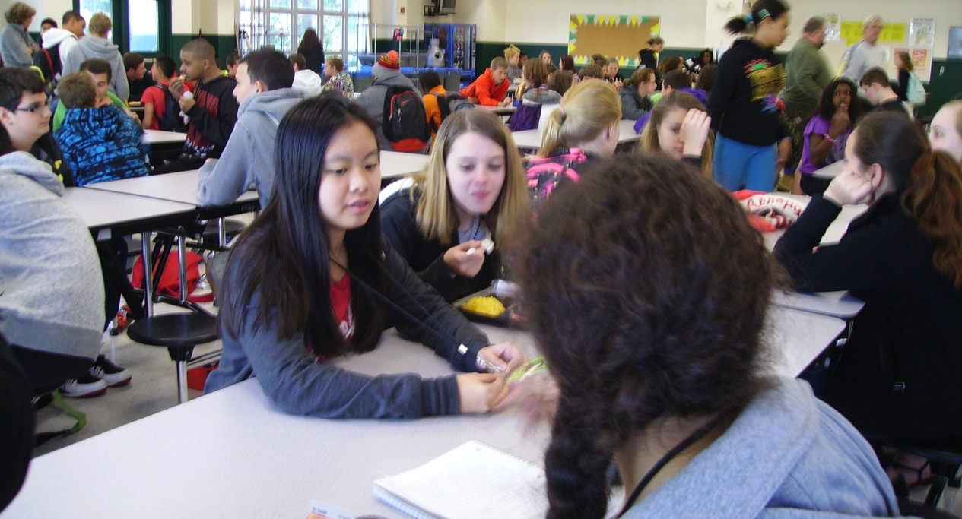
Lunch Procedures:
Watch and listen for specific directions
Use appropriate voice and language
Choose a seat and stay in that seat
Remain in seat until table is called
Raise hand to ask permission to leave seat

Slide 21
Lunch Procedures:
Forgot lunch or no money?
Cheese sandwich & milk
Inform adult, teacher, or administrator
Free and reduced lunch forms can be returned to cashier
Share table is available

Slide 22
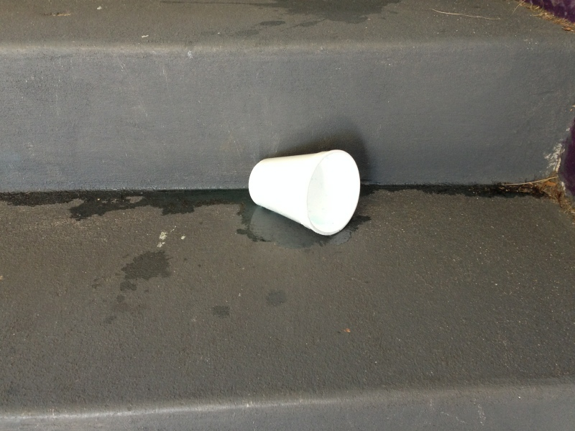
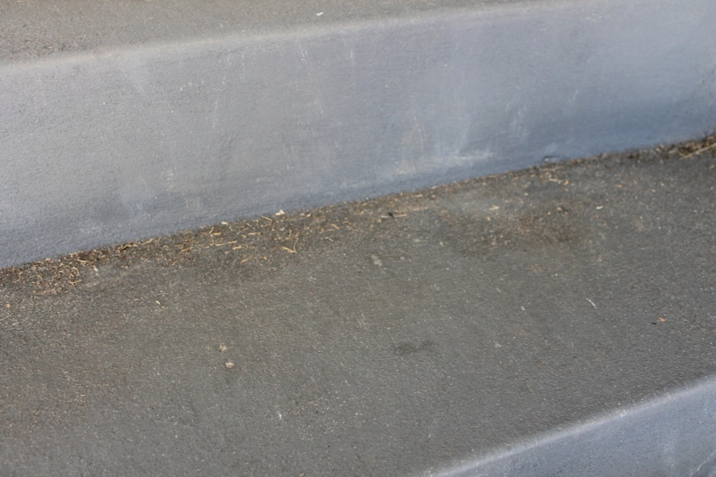
Lunch Procedures:
It is still sticky!!!
December 10th
December 18th
Opened container drinks & food may NOT leave cafeteria

Slide 23
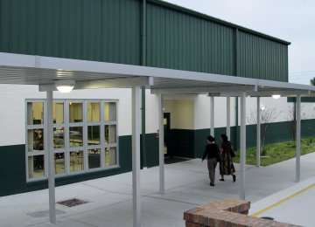
Lunch Procedures:
Return to class using appropriate hallways

Slide 24
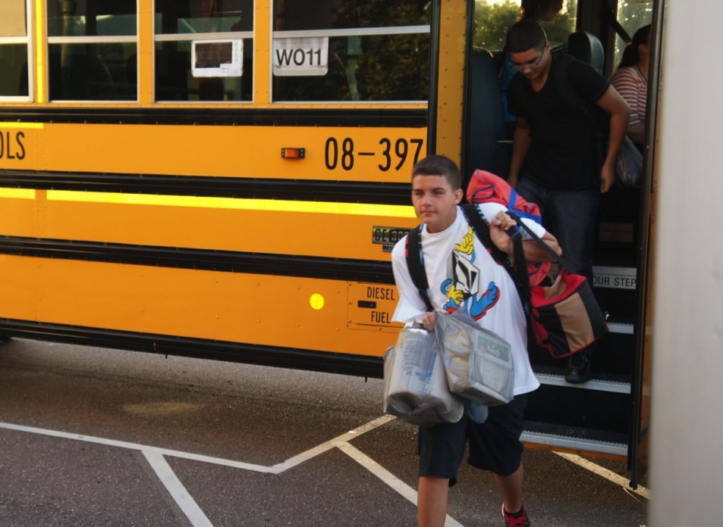
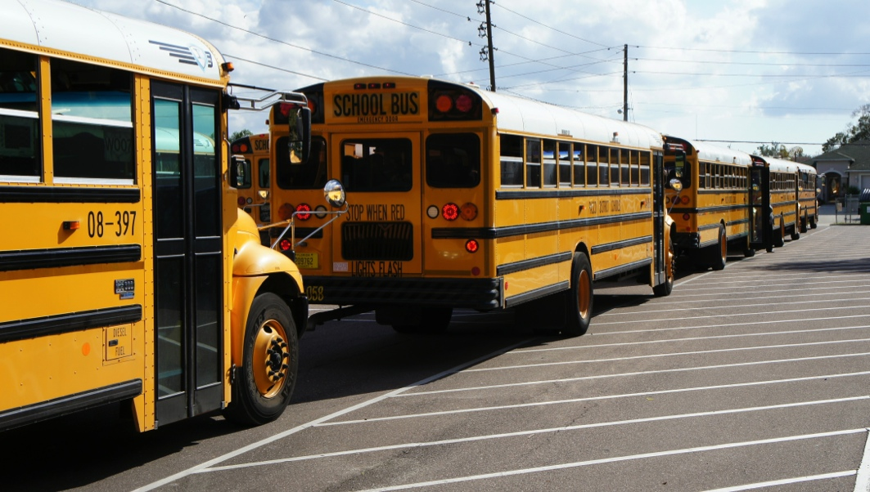
Transportation - Bus
Riding is a privilege (you can lose this privilege with your words and actions)
Be at your stop ten minutes early
Requests to ride other buses will not be granted due to space and safety concerns

Slide 25
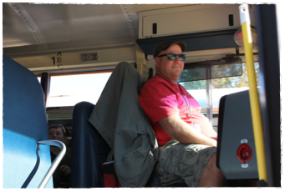
Transportation - Bus
At the 2:00 dismissal time, proceed directly to your bus. Buses will leave at 2:08 (with or without you)
Violation of transportation regulations endangers the safety of all
No balloons allowed on bus
Bus driver is the boss

Slide 26
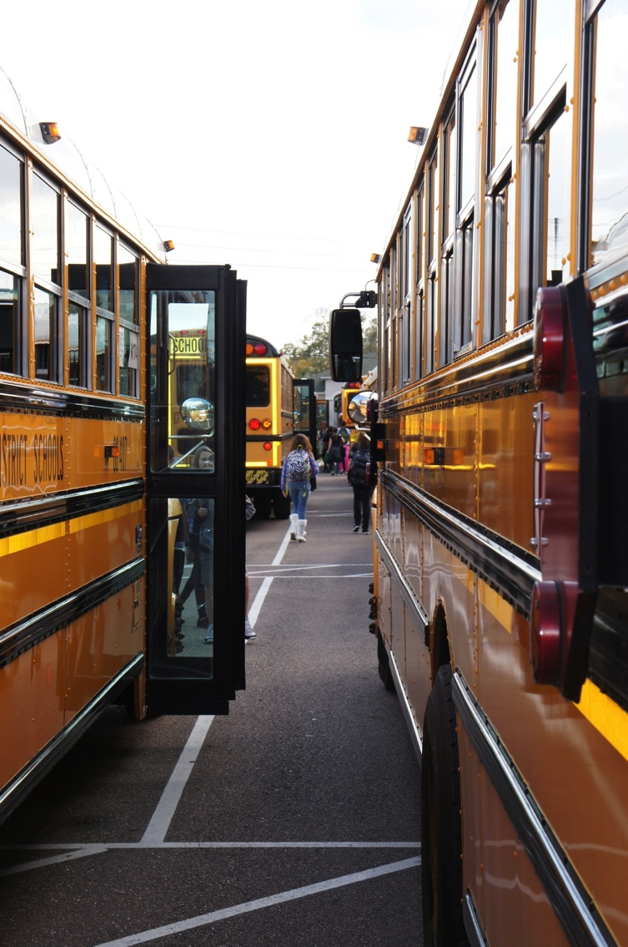
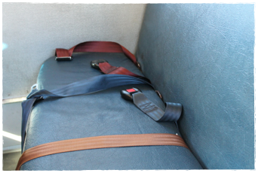
Transportation - Bus
Middle school students sit in front, High School students sit in back
Sit in assigned seat
Wear seat belts (when available)

Slide 27
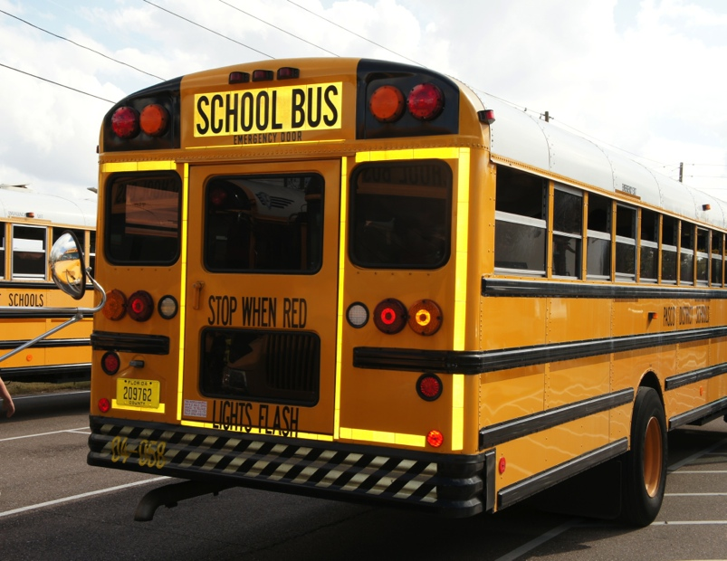
Transportation - Bus
Use indoor voice and appropriate language
No food or drink
Keep hands, legs, and belongings to yourself and inside the bus
Riding Is A Privilege
When you lose it with your words and actions, it is your responsibility to find alternative transportation

Slide 28
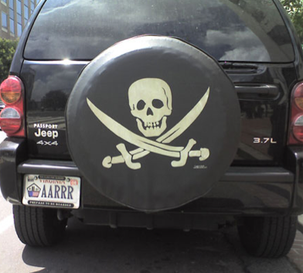
Transportation - Car
For the safety of all, parents and students must know parking lot procedures
Drop offs may begin at 7:15 am
Do not stay after school without permission
Students must be picked up by 2:30 pm

Slide 29
Transportation - Car
The telephone in the front office may be used if your ride is late

Slide 30
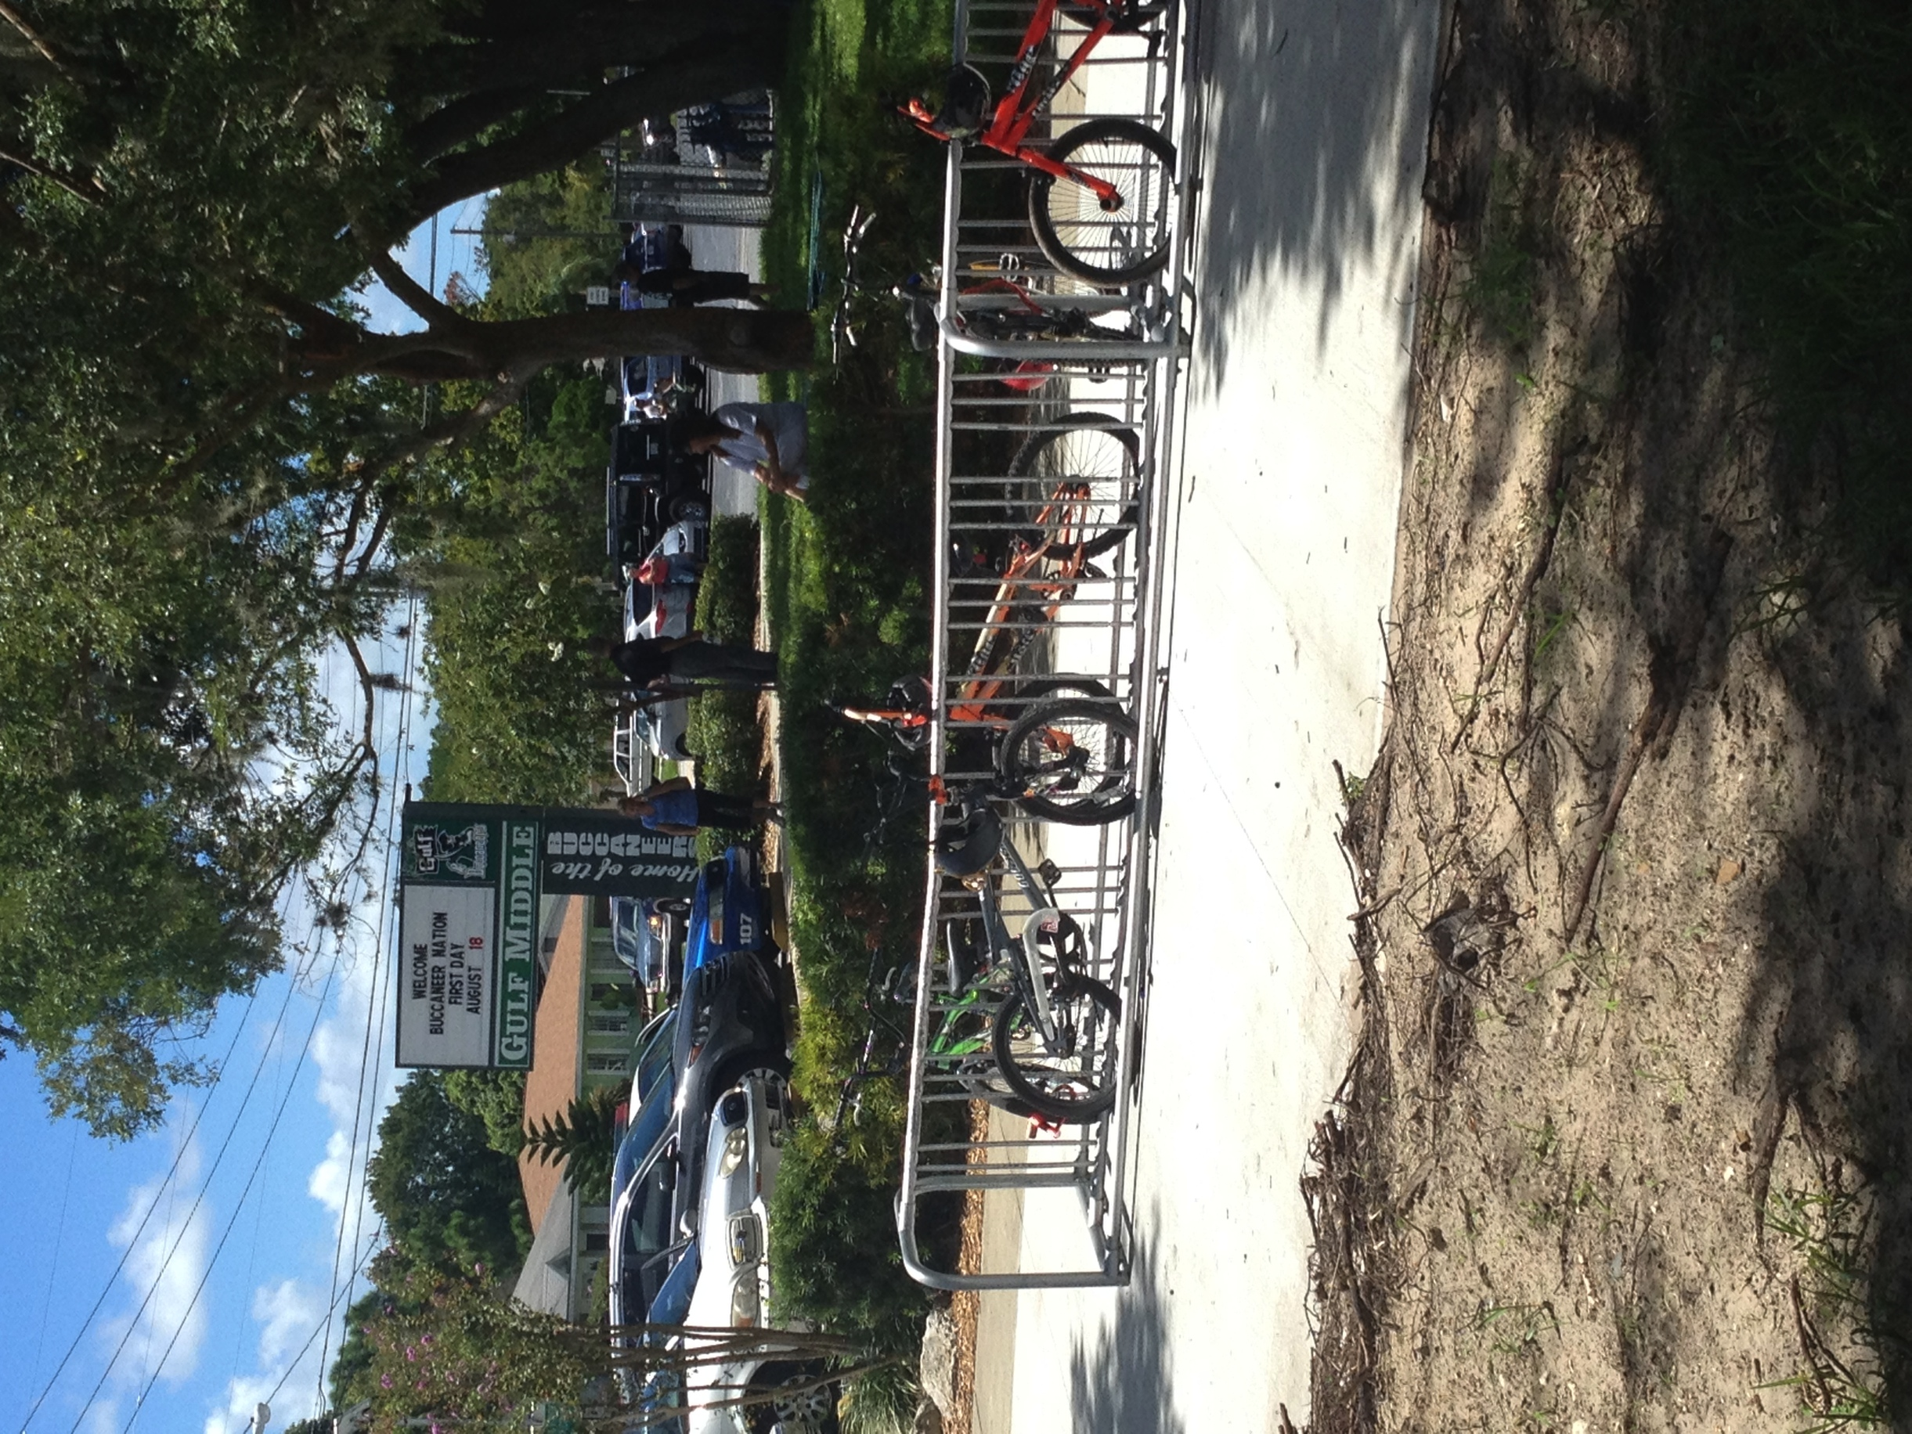
Transportation - Bike
Register your bike with the SRO
Park and lock in designated area
Locked during school day (opened after buses have left and parking lot has cleared)

Slide 31
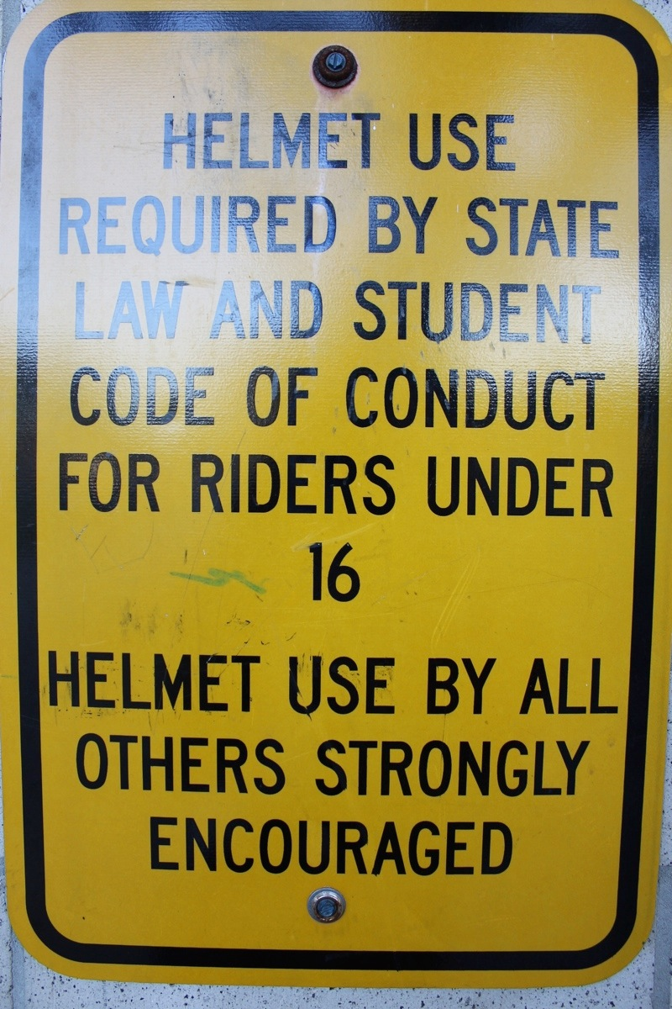
Transportation - Bike
Wearing your helmet is the LAW
Walk bike through populated areas
Stay on sidewalks whenever possible
Dismissed after buses

Slide 32
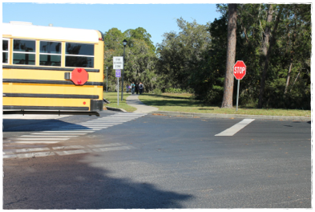
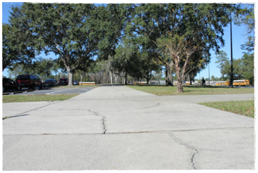
Transportation - Walkers
Walk directly home
Establish a walking partner

Slide 33
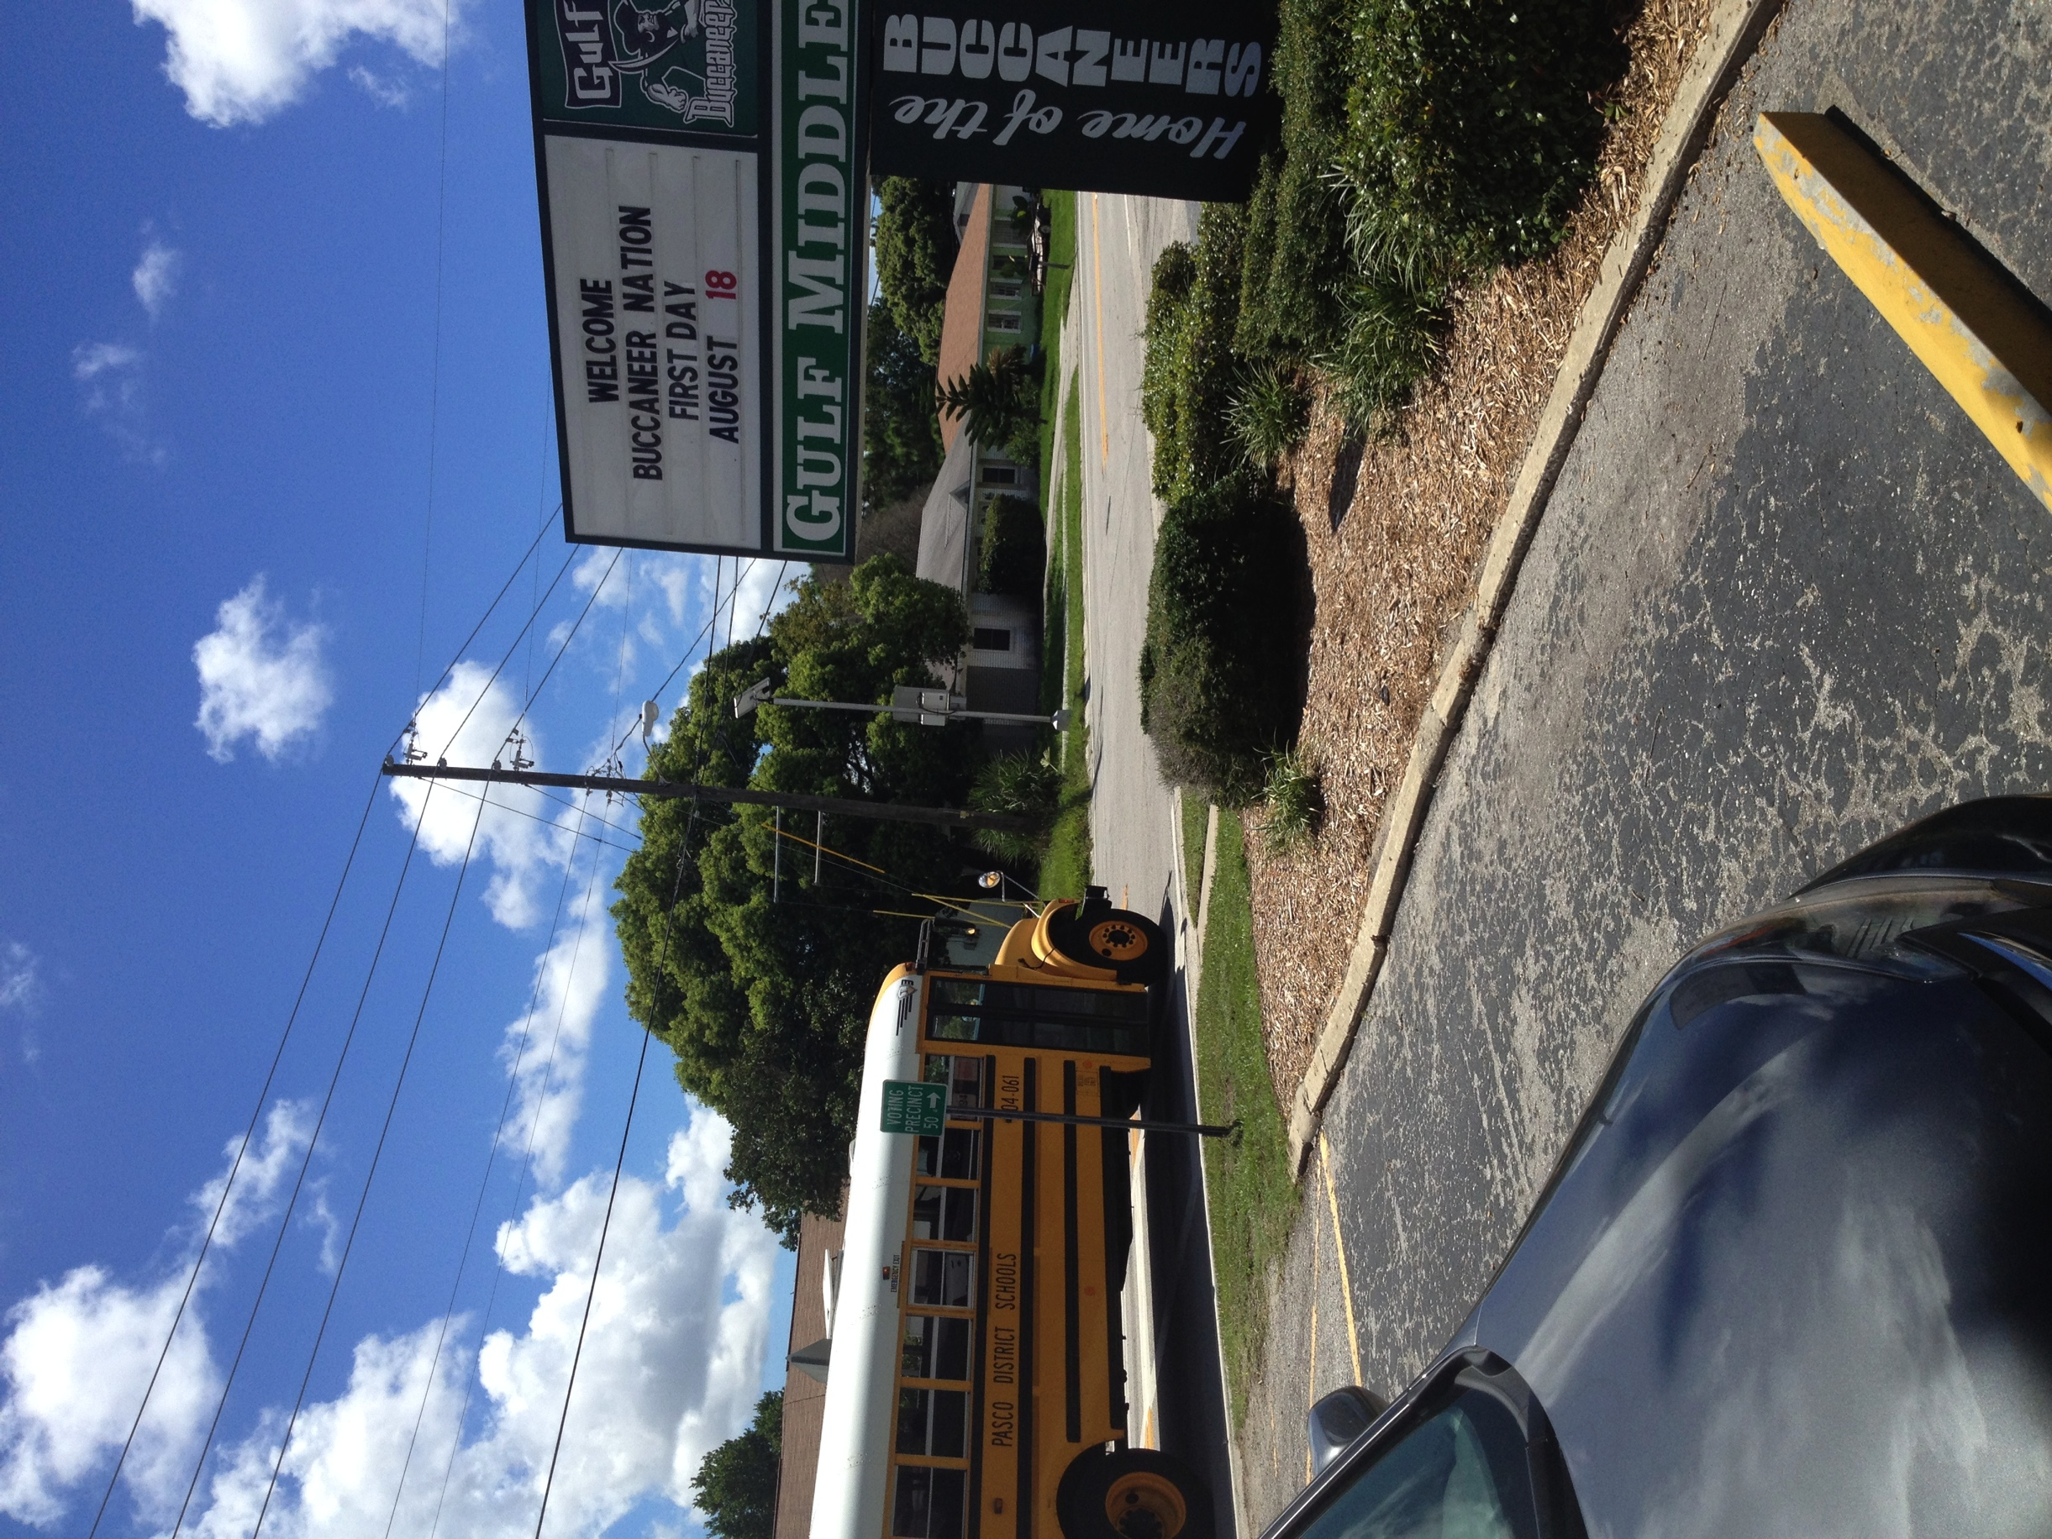
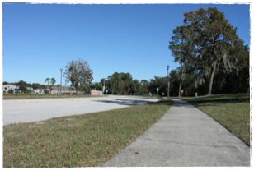
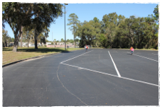
Transportation - Walkers
Wait for buses to clear prior to crossing any roads
Stay on sidewalks whenever possible
Do not cut across the bus parking lot

Slide 34
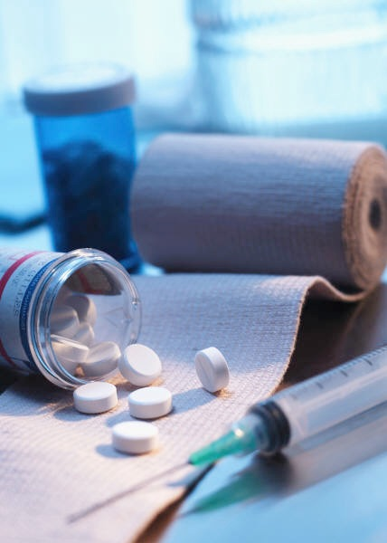
Medication
Students are not allowed to carry any type of medication on campus at any time
Administration of medication during school hours only by school nurse or trained personnel
Medication must be brought to school by parent in the prescription container
Students need a script from a doctor to use crutches or elevators

Slide 35
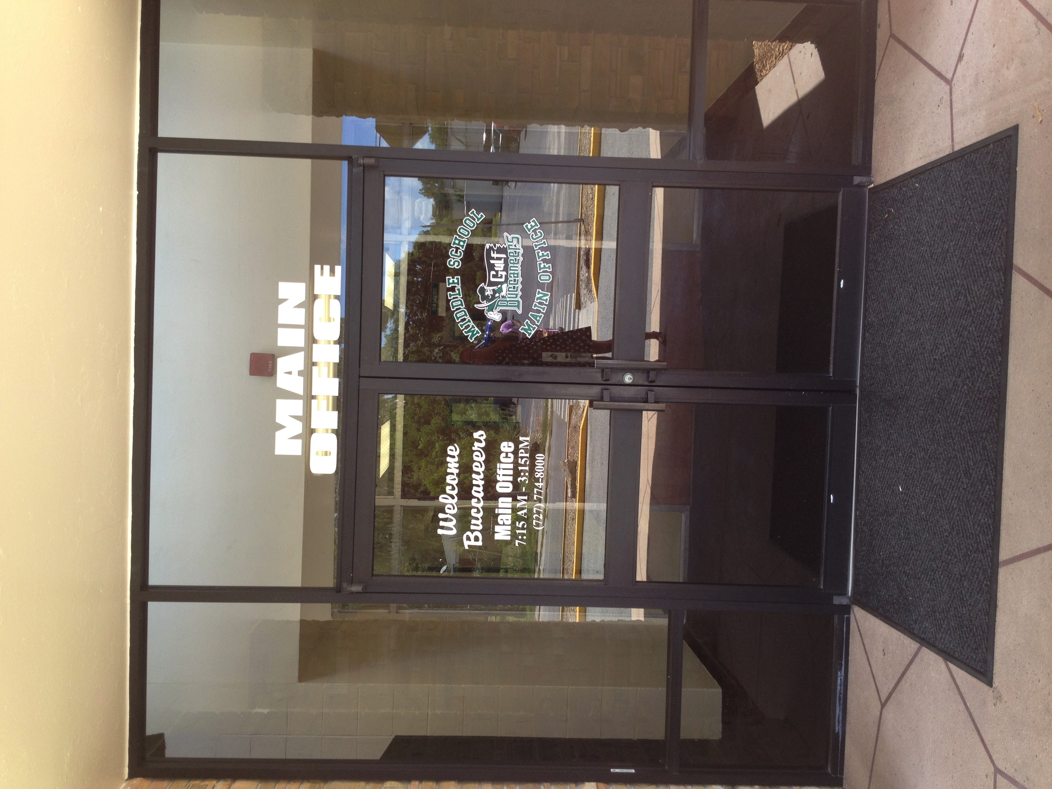
Main Office
All visitors need to check in at the Main Office

Slide 36
GMS is a
“Bully Free” environment!!!
Student reports to adult at school
School investigates (speak with students)
Document to track patterns of behavior
Implement appropriate intervention
A pattern of harassment constitutes bullying
Contact parents to share information

Slide 37
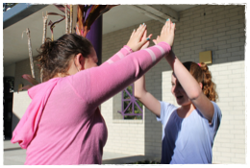
GMS is a
“Bully Free” environment!!!
Establish behavioral agreement between students
Entered in the Bully Program
If bullying continues:
Review patterns of behavior, contact both parents
Suspend bully
RESPECTFUL BUCCANEERS are NOT Bullies

Slide 38
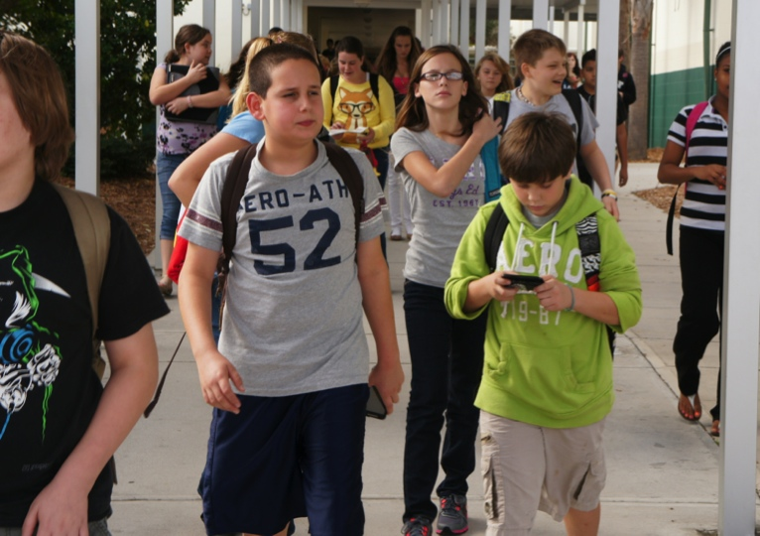
Policies and Procedures
Bring written notes for absences upon return to school. Give to first period teacher.
Come dressed appropriately. Student will be allowed to attend class only when properly dressed. Change or call for clothes or ISS.
If a student is suspended from school, either In School Suspension (ISS) or Out of School Suspension (OSS), they are not allowed to attend any school sponsored event or be on any school campus.
No hats or hoods
Whistle
One = Stop
Two = Move

Slide 39
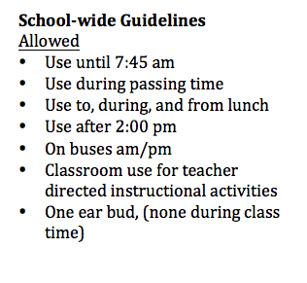
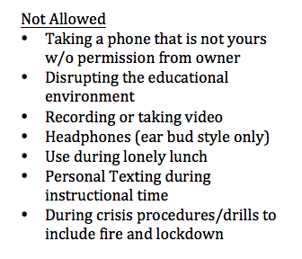
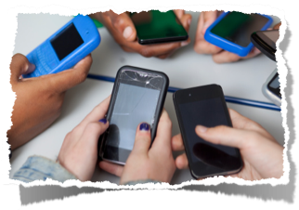
Bring Your Own Device Policy

Slide 40
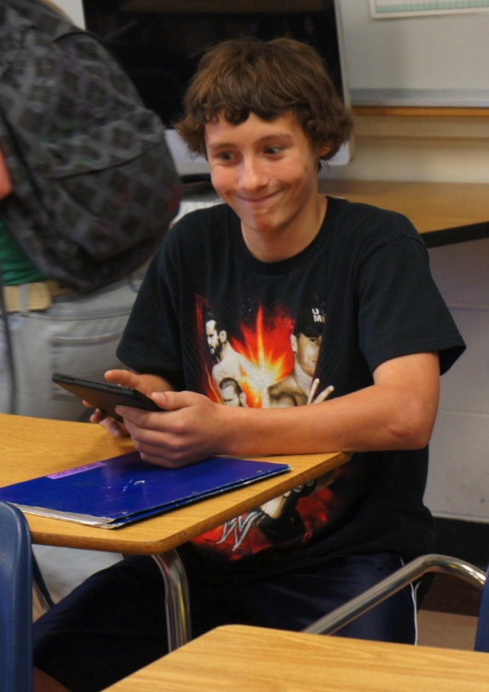
Bring Your Own Device policy

Slide 41
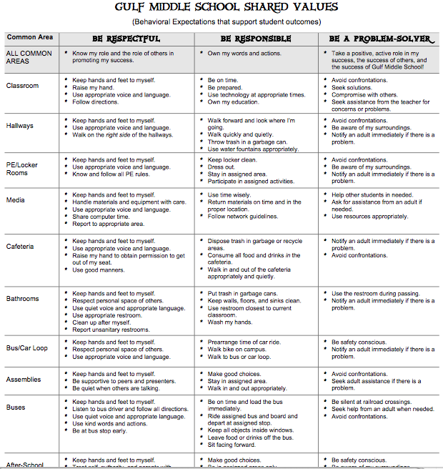
Social Matrix

Slide 42
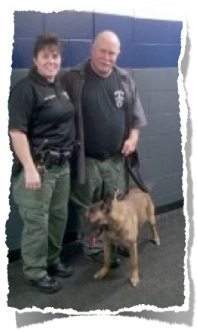
Keeping Safe:
Zero Tolerance
Weapons
Drugs
Possession of tobacco products
$25 citation & attend 2 hour class. $10 registration fee + school intervention of ISS.
Canine Search

Slide 43
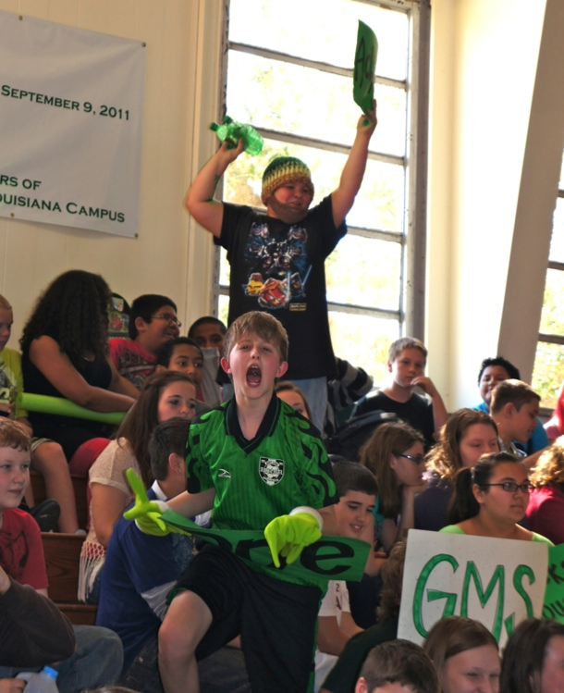
Athletics
7th and 8th grade students
Student athletes must maintain a 2.0 GPA
Athletic physical required
Show positive school spirit by supporting and cheering for the Bucs!

Slide 44
If You Have A Concern, talk to:
Teacher or any adult on campus
Guidance Counselors
Nurse or Social Workers
Mrs. Niland or Mr. Smith
Mr. Joens, Mrs. Kledzik, Mrs. Mobley or Ms. Schultz
Officer Wade
Request an appointment to ensure concerns are addressed.
Students must obtain a pass from a teacher before missing class.

Slide 45
For your success:
Know and follow all school and classroom procedures
Complete all work and turn in by due date
Accept re-direction
Live by the Shared Values in and out of the school & classroom
Be Respectful
Be Responsible
Be a Problem Solver

Slide 46
Have A Great Year!!!
Buccaneer Nation!

